Slide 1
AAA CORPORATE
MEMBERSHIP PROGRAM
24/7 Protection and Peace of Mind

Slide 2
For over 100 years, AAA has been there for its members, both on and off the road.
AAA is there for YOU
Our members enjoy exclusive benefits like:
AAA’s legendary 24/7 roadside assistance
Discounts on hotels, attractions, restaurants, and more
Expert travel and insurance services
AAA South Jersey Driving School courses
Savings at AAA Approved Auto Repair facilities
And so much more!

Slide 3
With AAA’s trusted Roadside Assistance you’ll have peace of mind knowing you’re covered when traveling to and from work, or anywhere else on the road.
24/7 Roadside Assistance
Roadside Assistance - Covers YOU in any car, whether you're the driver or a passenger
Mobile Battery Service – We’ll come to you to jump-start, test, or replace your battery if needed
Emergency Fuel Delivery - If you run out of fuel, we’ll bring you enough to get you to the nearest gas station
Tire Service - We’ll either install your usable spare, re-inflate your tire, or tow your vehicle
Locksmith Service - Locked your keys inside your car? We’ll send service to help you gain entry
AAA Approved Auto Repair – Members get 10% off labor costs and an extended 24-month/24,000-mile warranty on all parts and labor.
To learn more, visit: AAA.com/RoadsideAssistance
*Certain restrictions apply to these services. Review your Membership terms for full details.

Slide 4
Use your AAA Membership to get great deals on prescriptions, electronics, auto parts, clothing, eyewear, and more!
Exclusive AAA Member Discounts
To learn more, visit: AAA.com/Discounts
*Partners and discounts subject to change.

Slide 5
Enjoy even more savings on hotels, rental cars, and attraction tickets.
Exclusive AAA Member Discounts
Hotels
Hilton
Hyatt
Marriot
MGM
Rental Car
Hertz
Dollar
Thrifty
Local Attraction tickets
Adventure Aquarium
Hershey Park
Six Flags Great Adventure
Morey’s Piers, and many more!
To learn more, visit: AAA.com/Discounts

Slide 6
Save time and money on travel near and far with a AAA Travel Agent
Travel with AAA
FREE full-service travel agency
Help with planning
Road Trips
Cruises
Disney vacations
Universal Orlando Resort
Honeymoons
Vacation packages, and everything in-between!
Exclusive AAA Member Benefits and Savings on select packages
Additional AAA Vacation® Amenities available on select departures
Affordable single and multi-day Motorcoach trips
Honeymoon Registry with a Complimentary $100 towards your Vacation
FREE TourBooks, TripTiks, & Maps
Foreign currency
International driving permits
Official passport photos
To learn more, visit: AAA.com/Travel
Special Corporate Account Discount
SAVE 5% on your first travel booking with AAA!*
Start Planning Today!
1.888.577.9222 | AAA.com/Travel
*Cannot be combined with other offers. Other restrictions apply. See AAA South Jersey Travel Agent for details.

Slide 7
AAA Insurance
Get the peace of mind and quality service you expect from AAA
Policies available for:
Auto
Home and Renters
Life
Umbrella
Watercraft/boat
Motorhome/RV
Commercial
Pet
Vehicle Extended Service Plans
Save with a AAA Member Discount & more!
Personalized Service from knowledgeable, local AAA South Jersey Insurance Agents
Dependable protection that only our 100 years of experience, service, and reliability can bring
To learn more, visit: AAA.com/Insurance
Special Corporate Account Offer
Complete an insurance quote with a AAA South Jersey Insurance Agent and get a $10 eGift Card. Pick from The Home Depot®, Wawa®, Amazon.com®, Walmart® and many others!*
Mention Promo Code: 21CORPORATE
Talk to a AAA South Jersey Insurance Agent!
1.855.282.2275
*Offer expires 12/31/2021. Offer valid while supplies last. For full terms and conditions visit: AAA.com/Terms1

Slide 8
AAA Driving School
Trusted Behind the Wheel Lessons and Road Test Services
Licensed driving school from an established organization
Top of the line clean, late model training vehicles with dual brakes
Servicing Camden County, Gloucester County, Cumberland County, Burlington County, and Salem County.
Reduced pricing available for select lessons scheduled in the Fall and Winter.
Courses Available:
New Drivers
Courses that cover the fundamentals of driving
Road Test Services
Use of vehicle and practice before test
Refresher Courses
Nighttime driving
Winter driving
Parallel parking
Senior refresher lessons, etc.
To learn more, visit: AAA.com/DrivingSchool

Slide 9
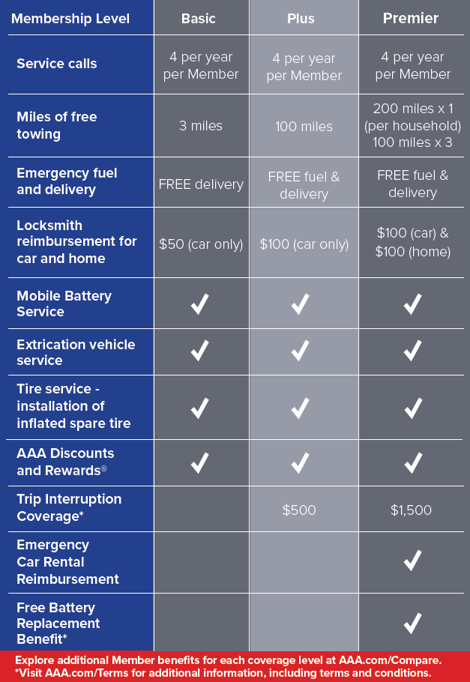
Choose the Membership Plan that’s Right for You
Explore additional Member benefits for each coverage level at: AAA.com/Compare
For additional information, including terms and conditions, visit: AAA.com/Terms

Slide 10
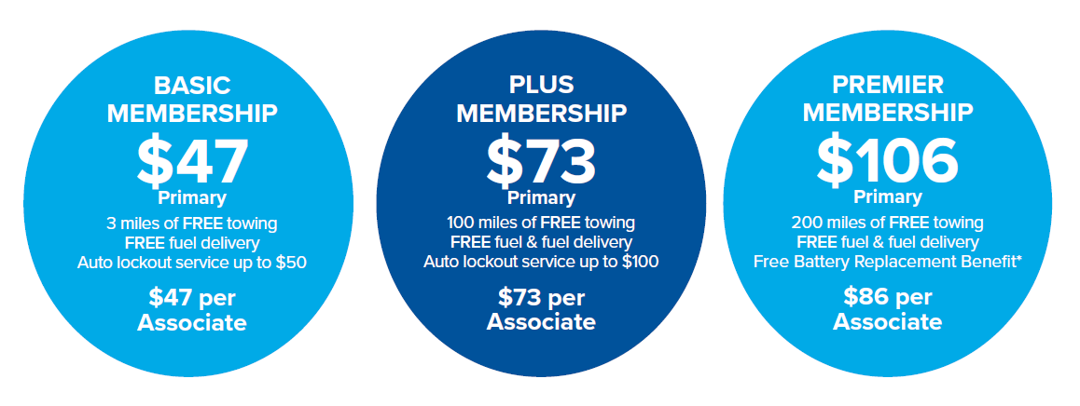
Special Discounted Pricing for Corporate Members
*Visit AAA.com/TermsOfUse for full restrictions

Slide 11
Join AAA Today with Your Company Discount
New AAA Members:
If you live within Camden, Gloucester, Cumberland, or Salem County:
Visit AAA.com/Join or call AAA Member Services at 855-772-5551
If you live outside Camden, Gloucester, Cumberland, or Salem County:
You must call AAA Member Services at 855-772-5551
Already a AAA Member and want to take advantage for your discount?
If you’re a AAA South Jersey member, club code “071”:
Call AAA Member Services at 855-772-5551 to provide the company code - discount will be applied at renewal
If you are not a AAA South Jersey member:
If your club code is not “071,” call AAA Member Services at 855-772-5551 when your membership is up for renewal
Provide the company code - We will transfer your membership to AAA South Jersey and apply the discount
New and Current Members can also complete the Membership Application provided by your HR rep and send to:
Shatera Brown sbrown@AAASJ.COM

Slide 12
Questions?
Contact Us
Shatera Brown
Membership Coordinator
700 Laurel Oak Road, Voorhees, NJ 08043
Office: 856.679.2655
Email: sbrown@aaasj.com

